Slide 1
SC1015 Mini Project Group 5
Dataset: Supermarket
Presented by:
Shawn Yap
Nicole Veronica Loke Yong Jian
Notes:
Hi, we are Group 5 from SC12, and today me and my teammates Nicole and Yongjian will be bringing you through the process and discoveries of our mini-project

Slide 2
1. OUR MOTIVATION
2. CLEANING OF DATASET
3. EDA
4. MACHINE LEARNING
5. PROJECT INSIGHTS
Introduction to dataset & Problem Statement
Process of cleaning dataset
Exploratory Data Analysis
Machine Learning Techniques & Prediction Accuracy
Outcome of the project and recommendations
Notes:
This will be the flow of our presentation - starting with 1) our motivation - introducing our problem statement and dataset, 2) the process of cleaning of dataset, 3) EDA, 4) Machine Learning Techniques and our Prediction Accuracy and lastly, project insights and recommedations.

Slide 3
01.
OUR MOTIVATION
Notes:
Firstly, our motivation for this project

Slide 4
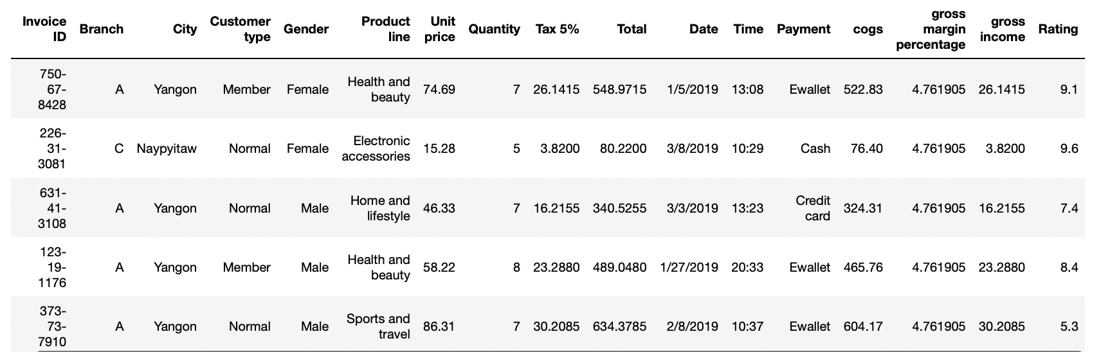
Our Motivation
Explore which purchasing habits differentiate Males and Females apart. From this, how successful will the model created be in predicting whether a customer is a Male or Female?
For the determining variables that distinguishes male and female customers, we will try to explore the rationale behind it to gain further insights
Notes:
Our dataset was a collection of purchasing habits of customers and further product statistics of supermarkets in various cities in Myanmar. As such, we will be exploring which purchasing habits could differentiate Males and Females apart. From this, how successful will the model created be in predicting whether a customer is a Male or Female?
For the determining variables that distinguishes male and female customers, we will try to explore the rationale behind it with the support of further research to gain insights into the trends and in turn, make some recommendations that could be applied in the real world at the end of our analysis.

Slide 5
02.
DATA CLEANING
Notes:
Now we will talk about the data cleaning section.

Slide 6
Data Cleaning
Dropping unnecessary columns
Checking if any Null-Value exists
Inspecting Categorical Data - Identifying unique values
Transforming raw time data (in 24-hour) to float (Numerical Data Type)
Converting date to day of week according to the Calendar
Checking for outliers for Numerical Variables
Further dropping another 3 similar columns
Dividing into two datasets (Male & Female)
Notes:
This is just a preview of the stuff that we have done.

Slide 7
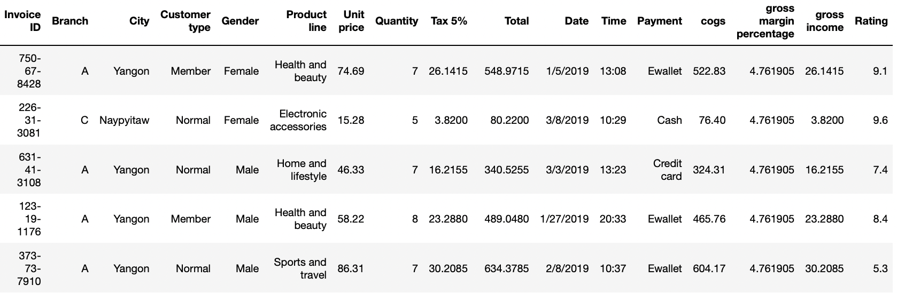
Data Cleaning
Dropping unnecessary columns
Branch - Directly linked to City, hence making it a repetitive info
Gross margin percentage - Repetitive and redundant data
Notes:
First, we start off by dropping columns that are not useful. We drop branch as it is directly linked to the City, hence it is repeated info. We also decided to drop gross margin percentage as the data appears to be repetitive and redundant.

Slide 8
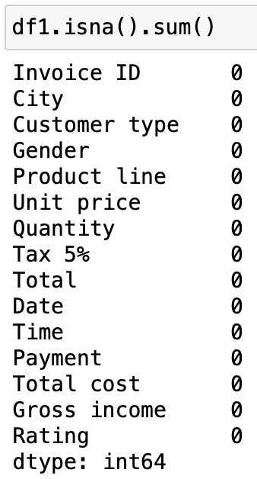
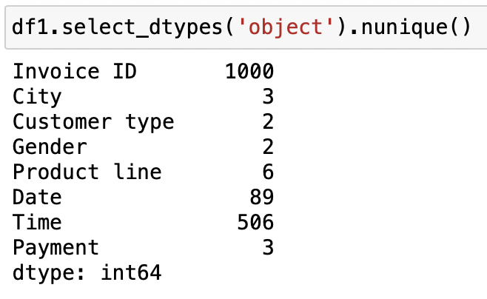
Data Cleaning
Checking if any Null-Value exists
Inspecting Categorical Data - Identifying unique values
Notes:
Next we check if there is any NULL value that we need to remove. We also take a look at how many different unique values those categorical data have so that we can have a rough idea before doing our EDA and machine learning.

Slide 9
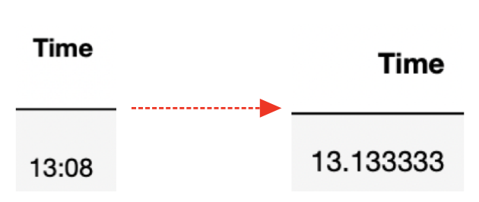
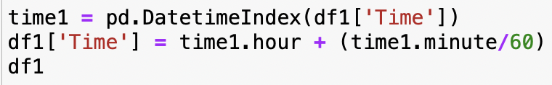
Data Cleaning
Transforming raw time data (in 24-hour) to float (Numerical Data Type)
Notes:
We google a way to convert the 24hr time format to something that the Jupyter notebook can recognise. It enable us to use it in EDA and Machine learning.

Slide 10
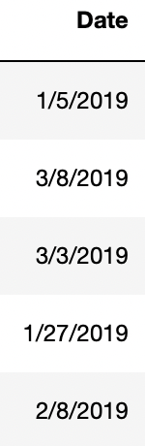
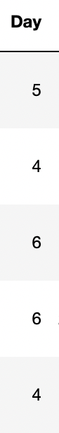
Data Cleaning
Converting date to day of week according to the Gregorian Calendar
For example: 23/04/2022 to Saturday, and it is represented by ‘6’ in the table)
Notes:
We have done the same thing for the variable named Date by changing the date format to day of a week.

Slide 11
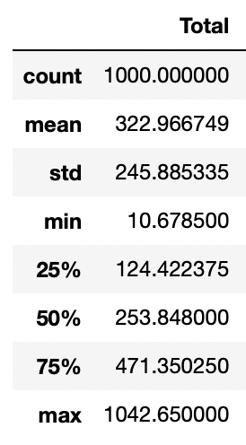
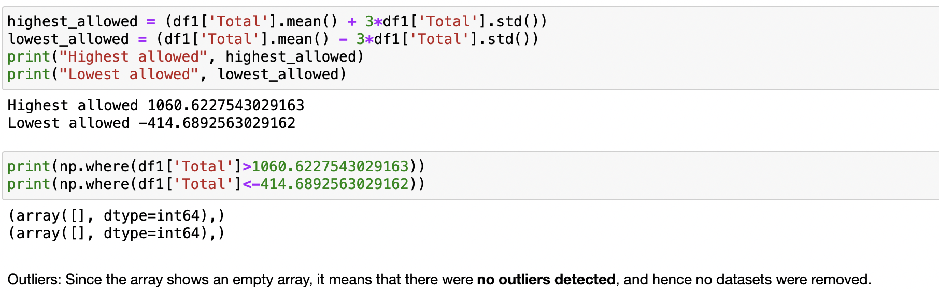
Data Cleaning
Checking for outliers for numerical variables
Remove data that exceeds the range of Mean + 3*Standard Deviation
Notes:
We understand the importance of removal of outlier. However, after verifying, we found out that our there is no outlier in our numerical data.

Slide 12
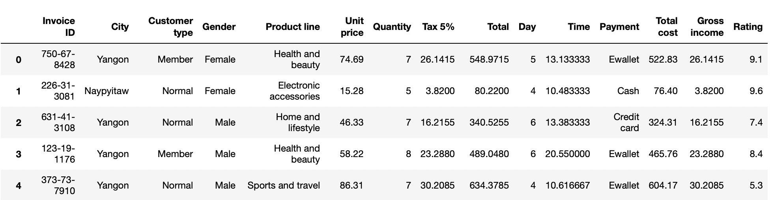
Data Cleaning
Further drop another 3 unnecessary columns that we found out later (Tax, Total Cost, Gross Income)
Notes:
While doing data cleaning, we realized that 4 of the variables are actually based on a common factor, making them repeated information. Hence we decided to remove 3 of the columns and only keep one of them.

Slide 13
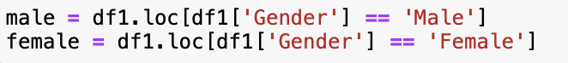
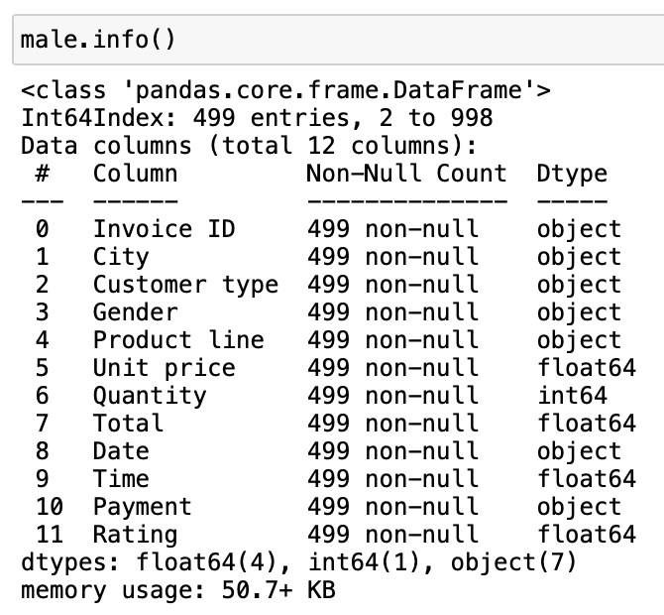

Data Cleaning
Splitting dataset to female & male, and checking if data is balanced
499 data entries
501 data entries
Notes:
For us to proceed on with finding the relationship between the variables and gender for some of the parts in the EDA sections, we split the dataset into "Male" & "Female".

Slide 14
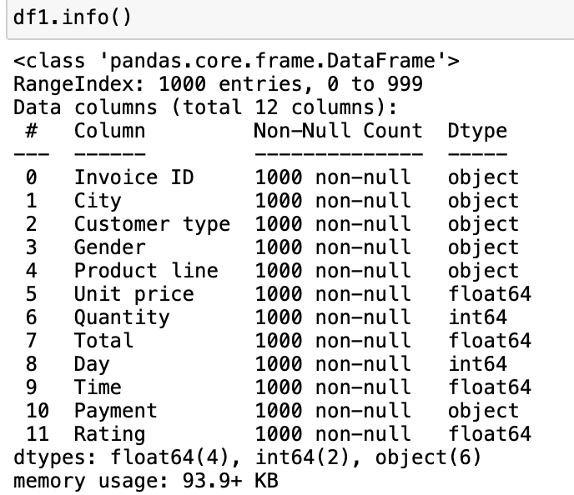
Data Cleaning
Check dataset if all conversions are done, to ensure that they are fit for EDA and Machine Learning
Notes:
Lastly, we do a last check to see if all the conversions are done and if they are ready for EDA.

Slide 15
03.
EXPLORATORY DATA ANALYSIS
Notes:
Now we will move on to EDA analysis part of the project

Slide 16
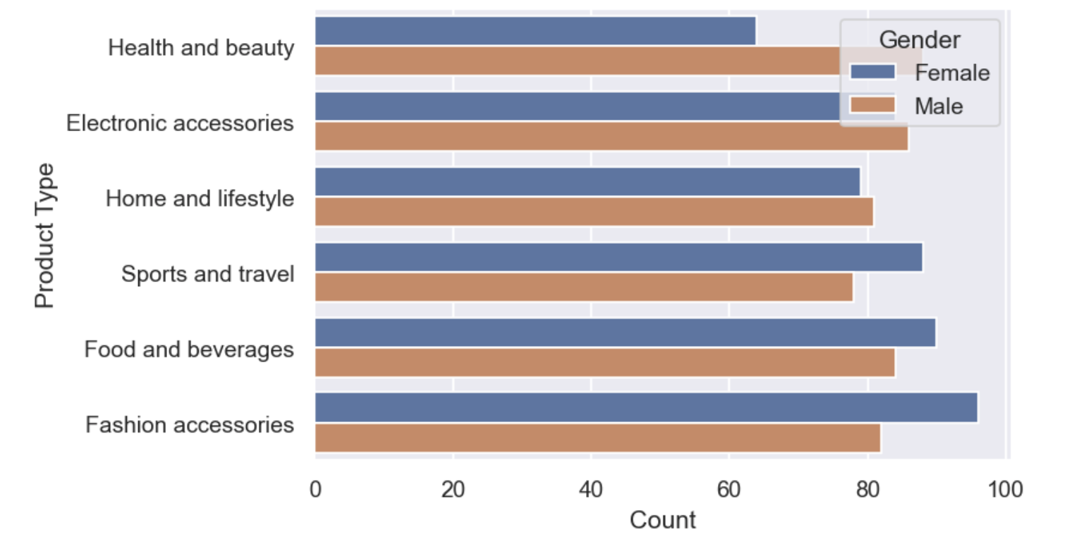
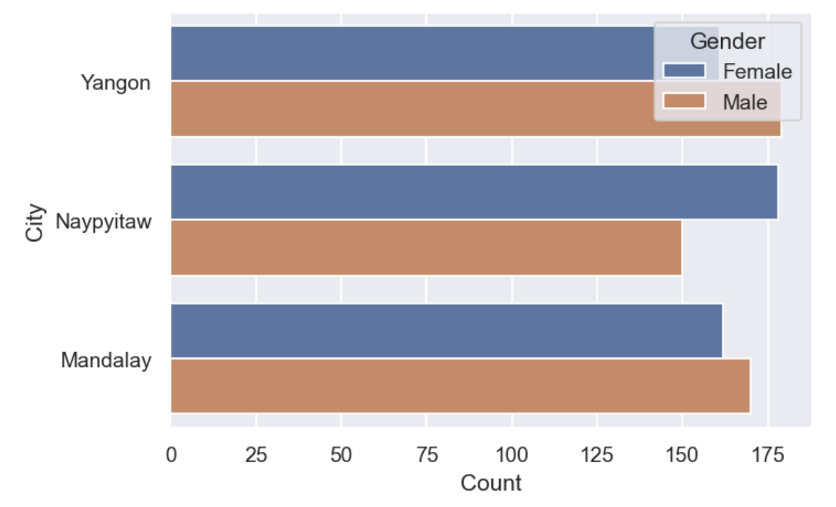
Categorical Variables EDA
PRODUCT TYPE
CITY
Notes:
Firstly, we use countplot to see the amount of different product line the male and female buy respectively. We can see that for "Fashion accessories", female has a higher count and it make sense. When looking at "Health and Beauty", we reckon that the reason why male is higher is due to the fact that male buys protein for their body building and protein is categorised under "Health and beauty" in the supermarket.
When looking at the chart which we compare city by gender, we can see that Naypyitaw has the highest number of male while Yangon has the highest number of female. This type of distinct relationship will make it useful in the prediction of the machine learning.

Slide 17
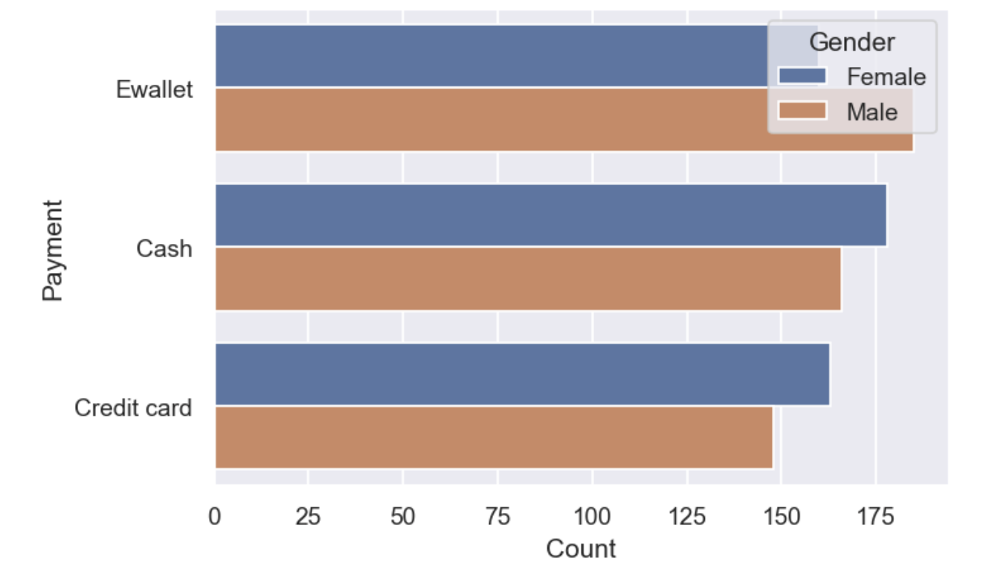
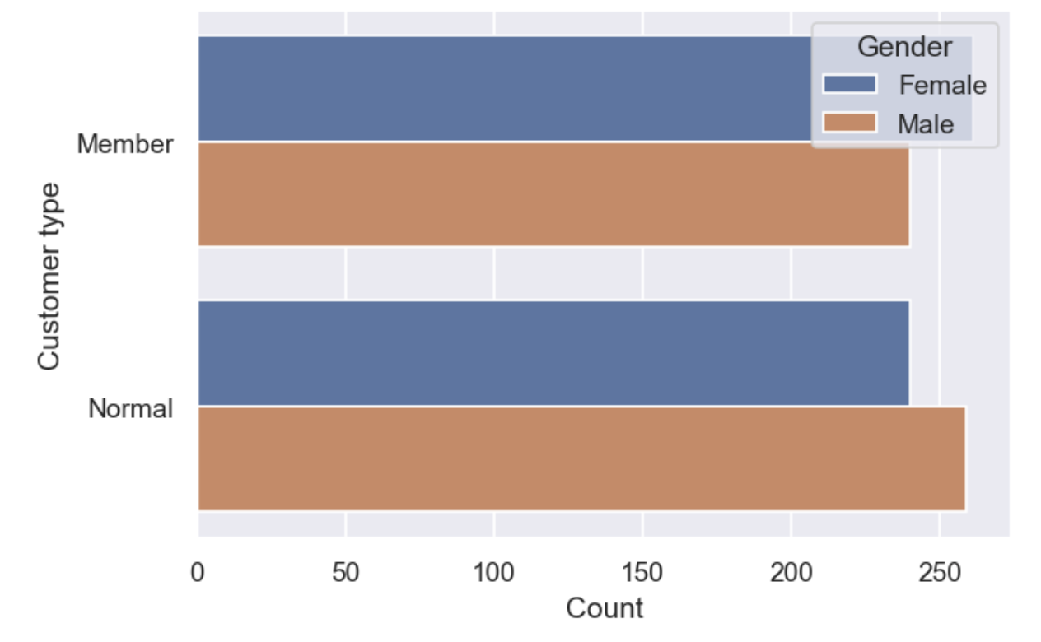
Categorical Variables EDA
PAYMENT
CUSTOMER TYPE
Notes:
Looking at the chart that compares the payment mode by gender, we can see that male prefer to use Ewallet while cash is preferred by female as a payment mode. Surprisingly, debit card and credit card is the least preferred type of payment mode. Next, for the chart comparing the customer type by gender, it is shown that there are more female member than male member, which make sense as female is generally a frequent customer and it is logical for them to apply for the membership.

Slide 18
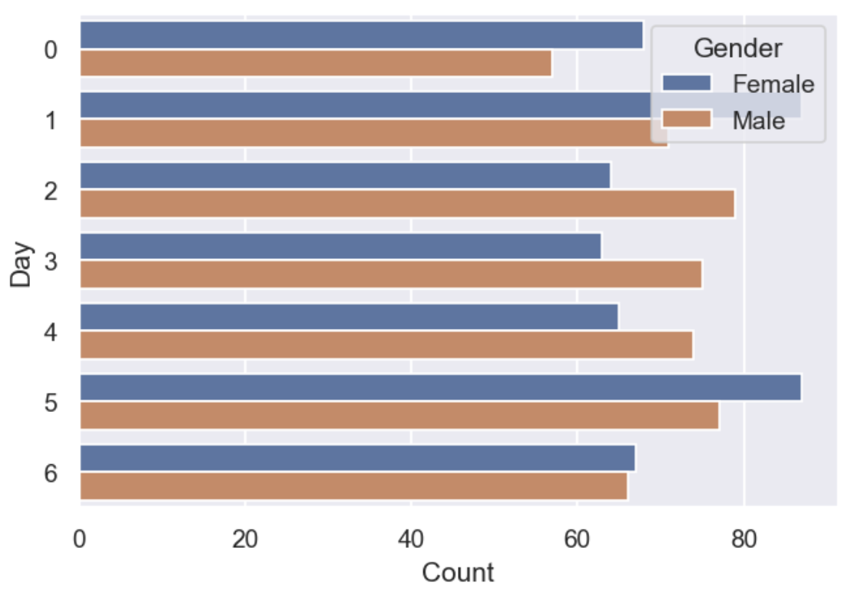
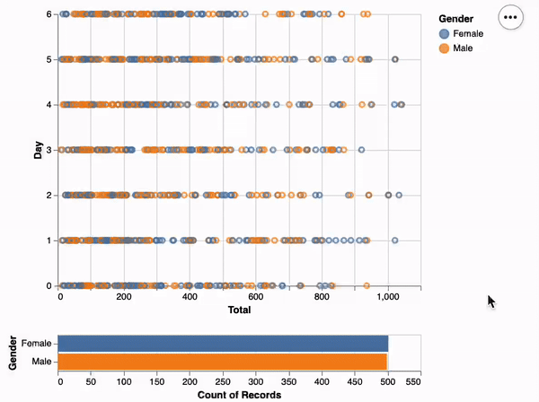
Categorical Variables EDA
DAY
DAY (Using Altair)
Notes:
Here is a chart comparing the number of male and female customers that visit a store in a span of a week. We can see that the female customers, most likely consists largely of housewife, normally go supermarket on Tuesday and Saturday, which is around the start and the end of a week as they might have to restock groceries for the family.
The right hand side is an interactive chart created using Altair. It allows user to select the day and see the combined total of male and female respectively, to help them to visualize in different perspective.

Slide 19
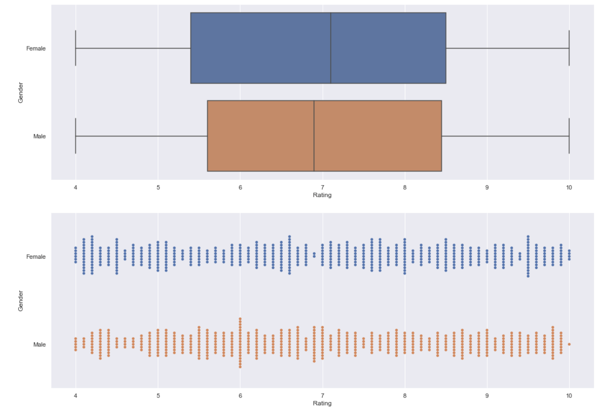
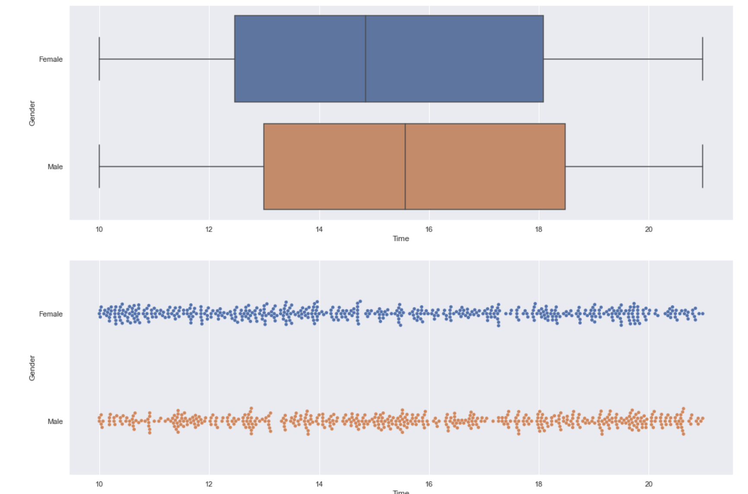
Numerical Variables EDA
Female
Male
RATING
TIME
Notes:
Moving on to numerical data, we have decided to plot a boxplot in order to clearly see the quartiles and median comparison between male and female. We also added a swarmplot such that we will be able to see clearly the frequencies of each value.
We can see from the boxplot that the overall rating given by females are higher than males, and also through the frequency shown in the swarmplot where for females the highest frequency is at 9.5 where for males it’s at 6.
As for time, we can see that males usually visit at later timings than females. This could be due to the higher percentage of males working, and hence only be able to afford the time to visit at a later timing.

Slide 20
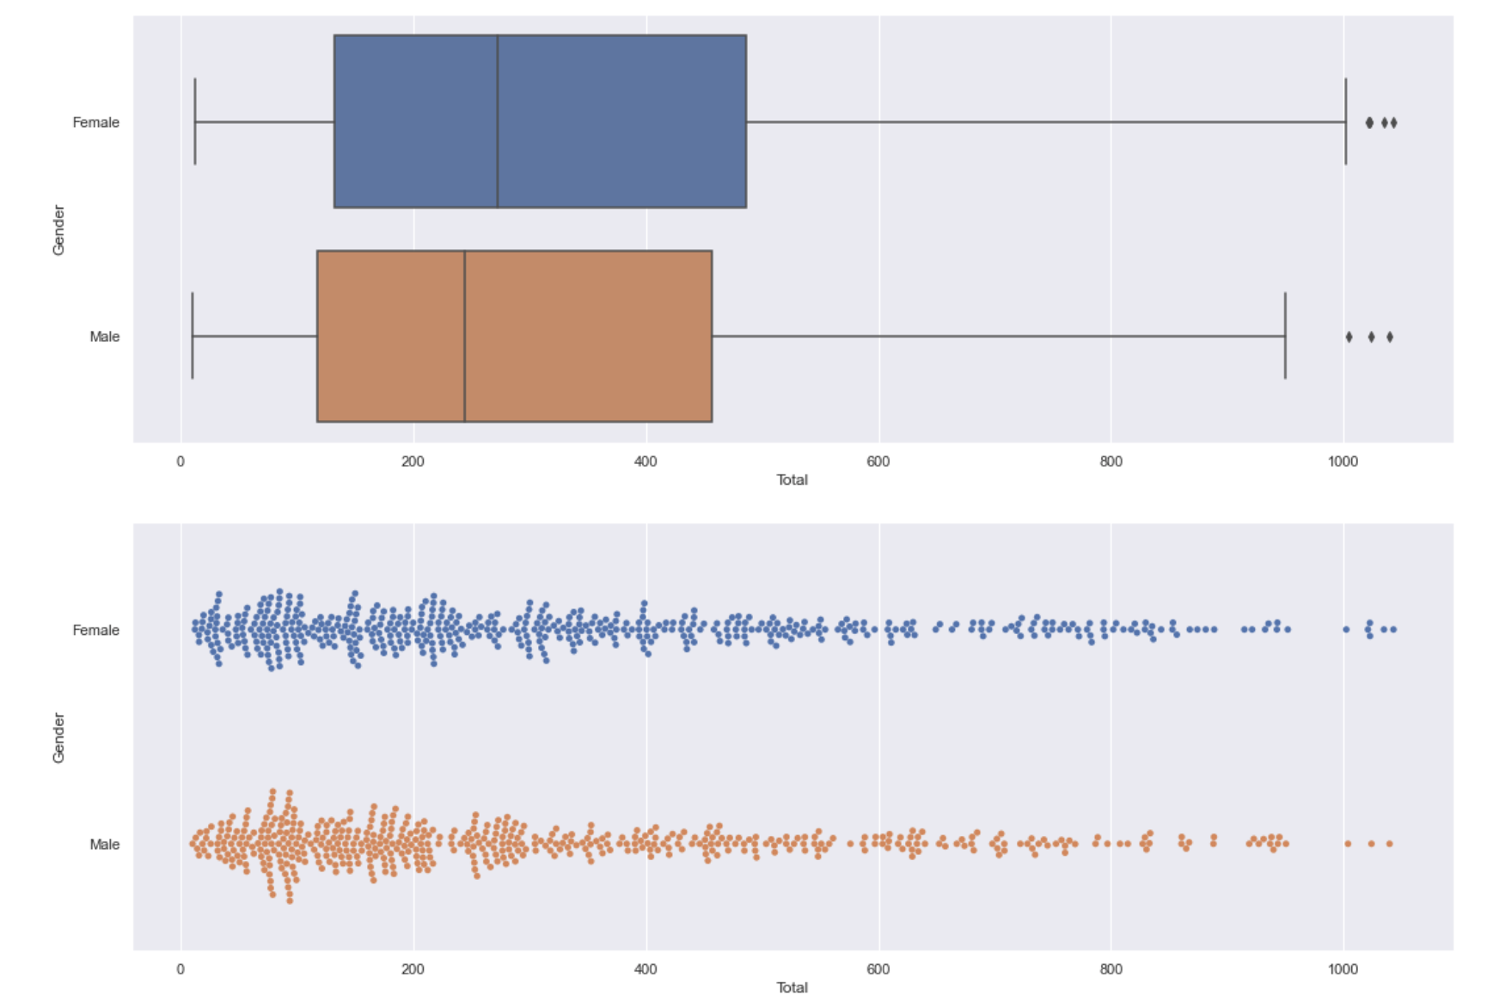
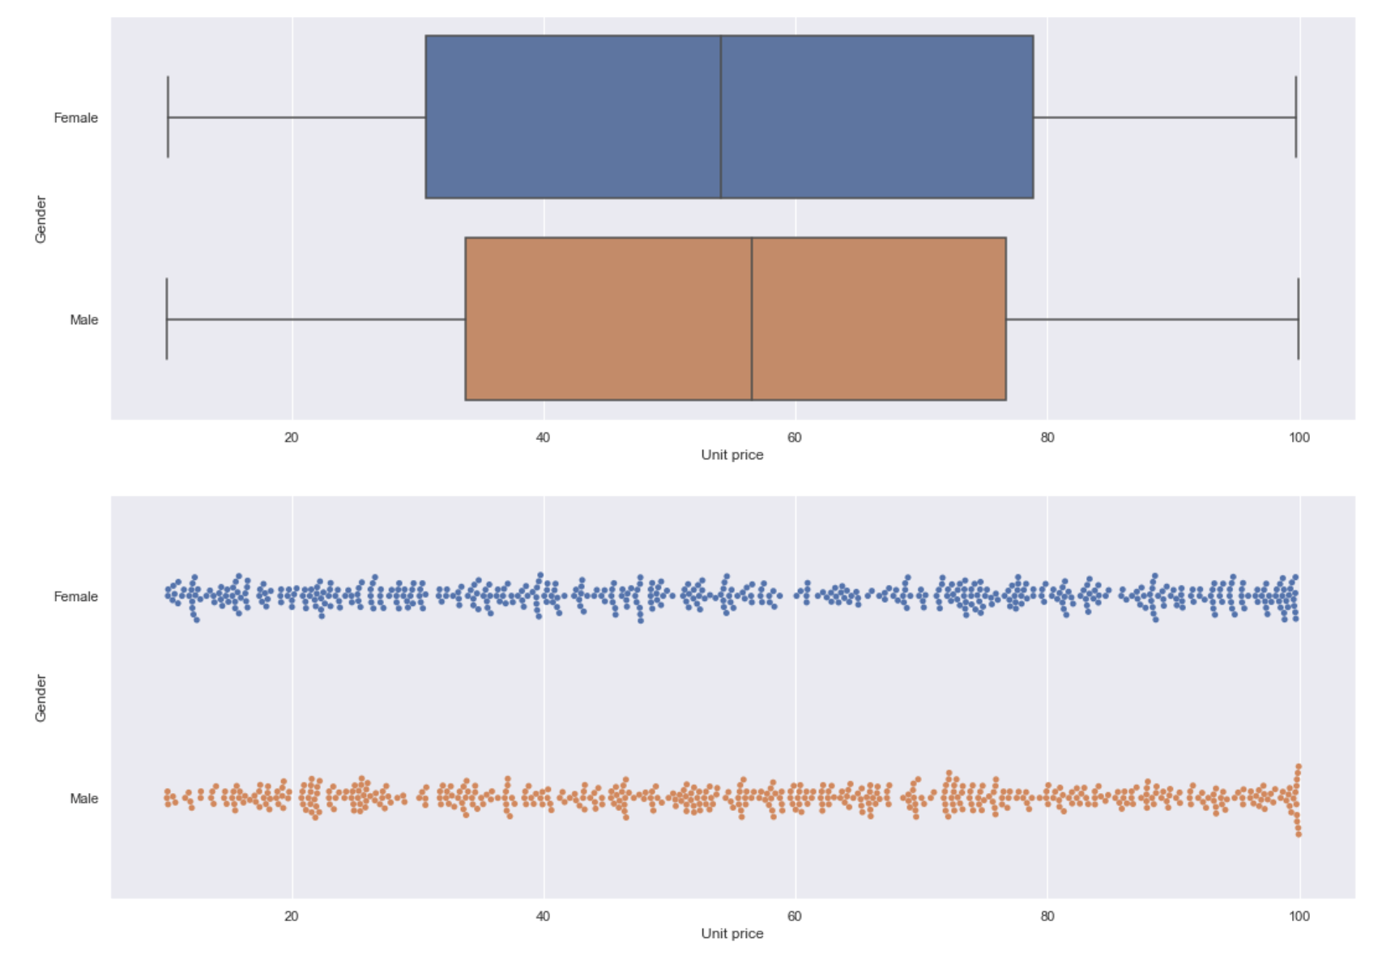
Numerical Variables EDA
Female
Male
TOTAL
UNIT PRICE
Notes:
Next, we also have total, where the spending for females in supermarkets are higher than males, possibly due to females commonly being the ones in charge of groceries for the family.
Furthermore, we also observed that the median unit price of items bought for females are slightly lower than males.
So, this will mark the end of the EDA, and we will continue with the machine learning techniques.

Slide 21
04.
MACHINE LEARNING

Slide 22
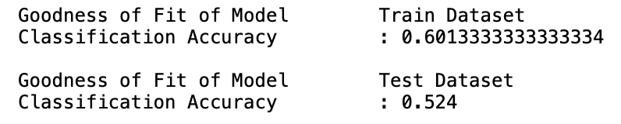
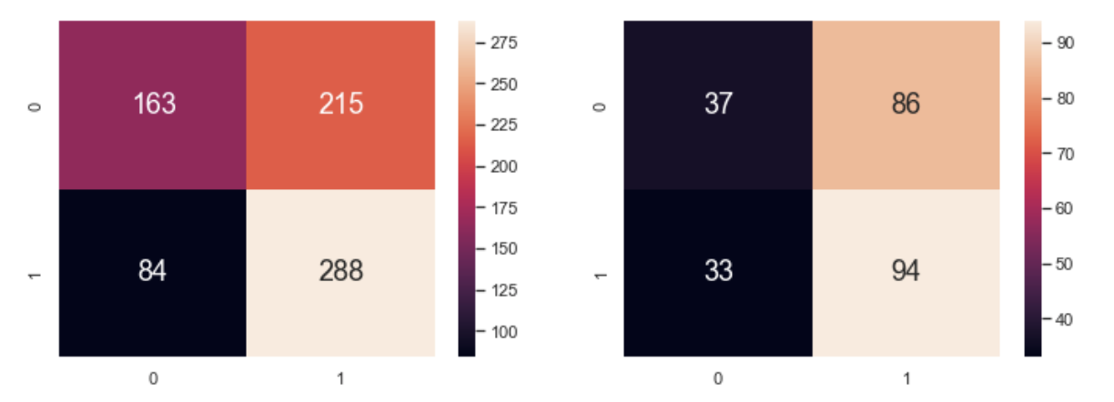
Multivariate Classification Tree (Numerical Var)
Response Variable :
Gender
Predictor Features :
Unit price
Quantity
Time
Total
Rating
Notes:
Firstly, we used a random train-test split of 0.75 and 0.25 for the numerical variables to create a multivariate classification tree. The response variable is the Gender and the variables include unit price, quantity, time, total and rating. The Classification Accuracy for train and test dataset is then calculated according to the confusion matrix. The train has an accuracy of around 0.6 and the test at about 0.52.

Slide 23
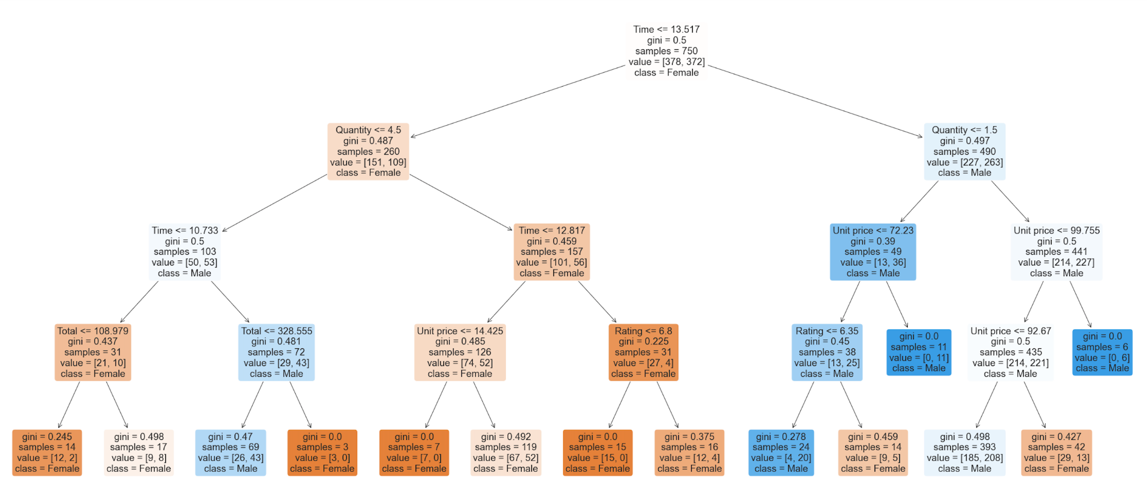
Multivariate Classification Tree (Numerical Var)
Notes:
This shows how the multivariate classification tree looks like. You can see that time occupies the topmost node, indicating that it has the highest correlation with Gender. It also successfully divides the left subtree into mainly orange colored which indicates female and the right subtree mainly blue colored which indicates male

Slide 24
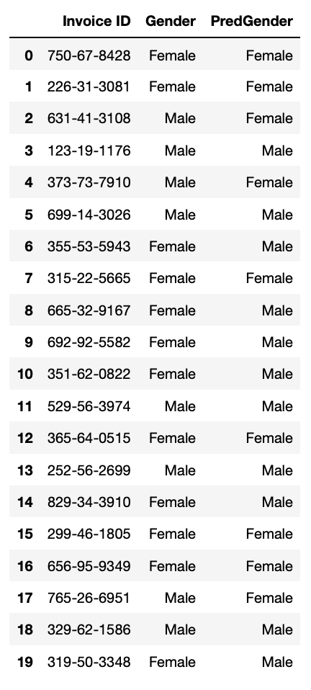
Multivariate Classification Tree (Numerical Var)
Accuracy
= (Correctly Predicted Genders)
= 55.0%
(Total samples)
Notes:
This shows a visualisation of randomly selected rows showing its real Gender and predicted gender. We then calculated the accuracy which resulted to be about 55%.

Slide 25
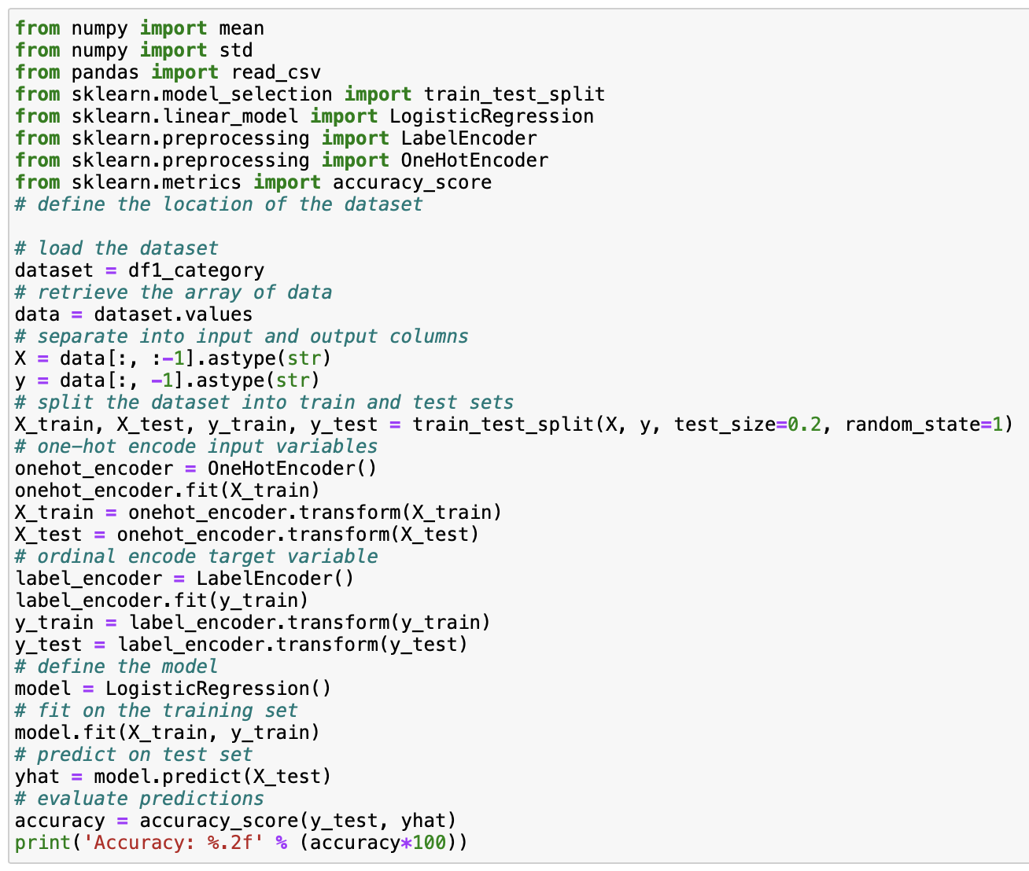
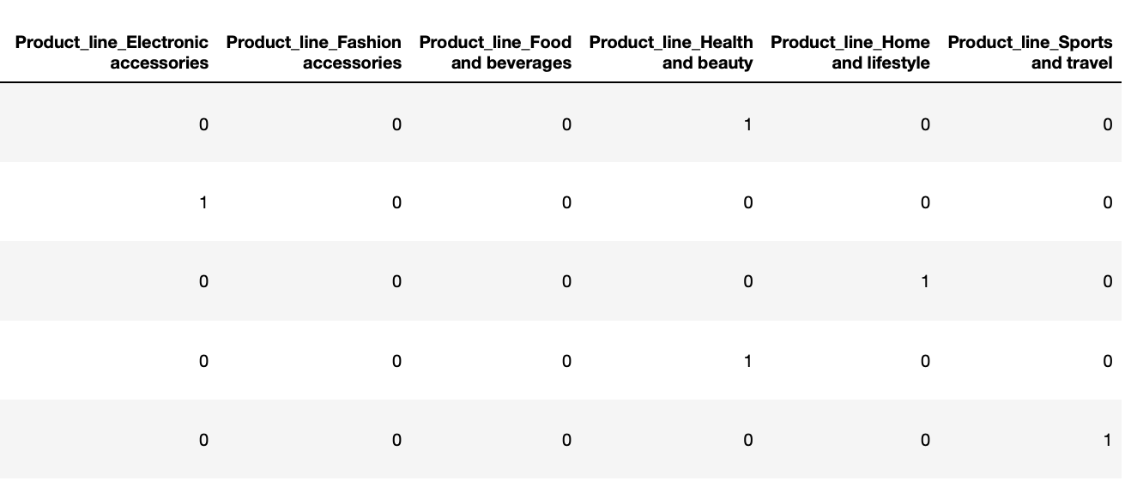
One Hot Encoding of Categorical Var (Extra Feature)
Converting non-ordinal (nominal) categorical variables to numerical so that we can use it in our machine learning
Logistic Regression using non-ordinal categorical variables
Accuracy = 38.50%
Notes:
As for the categorical variables, we had to perform one hot encoding in order to allow its usage for machine learning. We used one-hot encoding specifically for the non-ordinal categorical datas. This includes product line, payment method, customer type and city. This picture on the left shows a sample row for the one-hot encoded product line variables. Whichever product line the customer has purchased will be marked as 1.
On the right side, we also applied logistics regression using the one-hot encoded variables where the accuracy resulted to be way lower, with only 38.5%. This figure is much lower than 55% when using numerical variables, showing that the categorical variables have lower correlation with gender compared to the numerical variables.

Slide 26
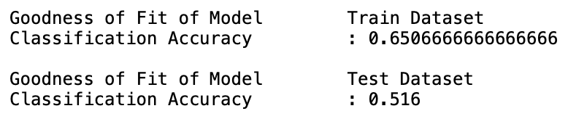
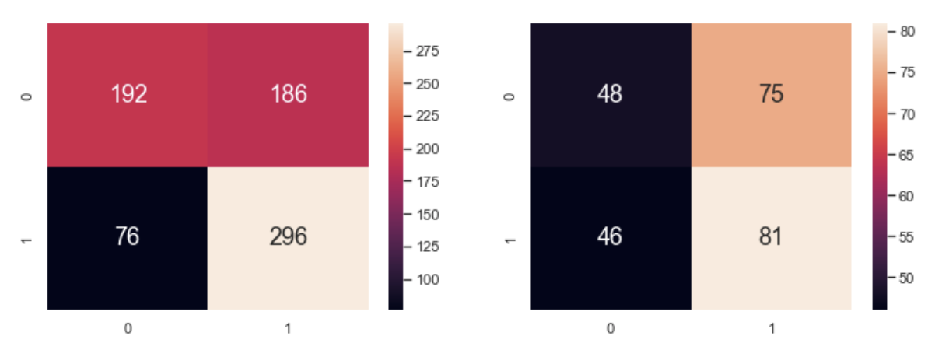
Multivariate Classification Tree (Num & Cat)
Response Variable :
Gender
Predictor Features :
Unit price
Quantity
Time
Total
Rating
Day
Payment
Product Line
City
Customer Type
Notes:
Then, we repeated the same step of creating the multivariate classification tree, but this time with the additional categorical variables that we have one-hot encoded. This shows the confusion matrix and their corresponding accuracies.

Slide 27
Multivariate Classification Tree (Num & Cat)
Numerical Tree
Numerical & Categorical Tree
Similar! Why?
Notes:
But if we look closer, and compare side by side the previous numerical tree and the combined tree, their classification accuracy are actually very similar. So, why is this happening?

Slide 28
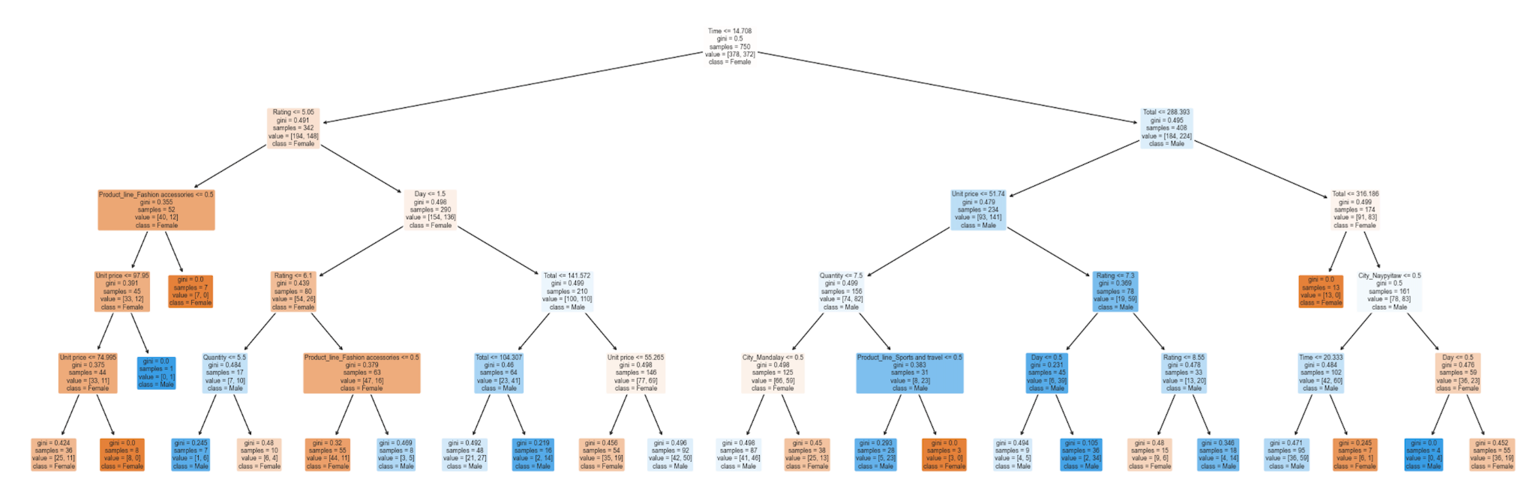
Multivariate Classification Tree (Num & Cat)
Numerical variables are still seen to dominate the upper nodes:
Numerical variables have stronger correlation compared to categorical variables
This explains the similar accuracy achieved by both trees
Rating
Time
Total
Product line
Total
Day
Unit price
Notes:
So, the way a classification tree works is by selecting the stronger variables to split. Hence it is possible to have a tree dominated with numerical variables even though there are more //categorical variables.
As we looked into our tree, we realised the similar accuracies was due to the numerical variables dominating the upper nodes. The red labels here indicate the numerical variables. This means the numerical variables have stronger correlation with gender compared to the categorical variables. As such, it is natural that the numerical tree and the combined tree have similar accuracy.

Slide 29
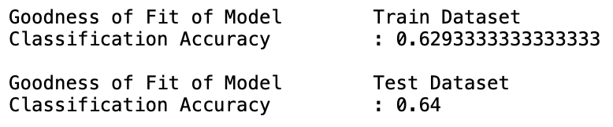
Random Forest (Extra Feature)
Using the combined (numerical & categorical) dataset, further machine learning using Random Forest is done.
It can be seen that the accuracy for the test dataset increases significantly from the previous multivariate classification tree.
Numerical & Categorical Multivariate Tree
Random Forest
Notes:
Thus far, the classification accuracy for the test set is still not very high at around 0.5. So we decided to explore more ways to improve this accuracy, and decided to use Random Forest.
Random forest essentially consists of a large number of individual decision trees that operate together. Each individual tree will produce a class prediction and the class with most votes will become the model’s prediction.
So after applying the random forest, we saw a significant increase in the test dataset accuracy by more than 10%, from 0.51 to 0.64.

Slide 30
05.
PROJECT INSIGHTS
Notes:
Lastly, we will end off with our project insights

Slide 31
OUR MOTIVATIONS
Explore which purchasing habits differentiate Males and Females apart. From this, how successful will the model created be in predicting whether a customer is a Male of Female?
For each variable that distinguishes male and female customers, we will try to explore the rationale behind it to gain further insights
Notes:
To conclude, we will be referring back our motivations behind this project as seen in the previous slides

Slide 32
More Significant Variables
The variables on the upper level nodes are chosen because they best split that node. Hence, those on top can be said to have higher correlation with Gender (better predictors)
Rating
Time
Total
Product line
Total
Day
Notes:
To answer the first question:
Now that we have done our model as explained by Nicole previously, we have identified the significant variables highly correlated with gender. They are seen in the upper level nodes in the classification tree as shown above, with Time, Rating, Total, Product Line and Day as the significant variables

Slide 33
Comparison (Key Characteristics)
 | FEMALE | MALE
TIME | < 3.00pm | > 3.00pm
TOTAL | > $288 | < $288
RATING | >= 6 | < 6
PRODUCT LINE | Fashion & Accessories | Health & Beauty
DAY | Saturdays & Tuesdays | -
Notes:
We then condensed it down into this table, which shows the difference in trends per gender given the leading variables.
For Time - we would assume that there is a larger population of males working -> only can visit at a later time
For Total - females likely to be in charge of grocery shopping as a family unit, hence leading to higher net spending per visit
For Rating - we found that females are more generous in their ratings as compared to males which could be due to many factors, such as interaction with the store personnel
For Leading Product Line - We found that fashion and accessories corresponds mainly to females while Health and Beauty corresponds mainly to Males. As Yong Jian explained briefly earlier, this could be tied to the nature of products each gender are looking for in the supermarkets, with females inclining towards Fashion or Accessory-related products and males inclining to Gym-related products, which would correspond to Health and Beauty.
For Day, we had no significant findings for males but interestingly enough found that females would patronise more on Saturdays and Tuesdays, which would fuel our recommendations later on.

Slide 34
RECOMMENDATION #1
Increase the quantity of
Fashion & Accessories products (most popular product line for female)
To target to more females (as they have an average higher spending) -- in order to increase sales
Notes:
From our EDA and machine learning, we have found out that Fashion & Accessories is the most bought product line for females. Since females also have an average higher total spending than males, it would be a good strategy to target females in order to increase sales.
Hence, one recommendation that could be done is to increase the quantity of items in the Fashion & Accessories category, such that it would lead to an increase in overall supermarket revenue.

Slide 35
RECOMMENDATION #2
Implement a ladies discount every Tuesday & Saturday (from opening hours to afternoon 3pm), where frequency of females visiting is the highest
Highest frequented day and time for female customers is chosen such that we know they are available at these timings to visit the supermarket
Ladies discount in order to attract them to purchase items and increase sales
Notes:
Another recommendation is to implement a ladies discount every Tuesday & Saturday from opening hours to 3pm where frequency of females visiting is the highest.
We chose the highest frequented day and time for female customers as this would then guarantee that they are likely to be available to visit the supermarkets at these timings.
This ladies discount will then help the supermarket to attract more females and purchase items in order to increase sales and total revenue.

Slide 36
:)
Thank You!!

Slide 37
References
https://stackoverflow.com/questions/38067704/how-to-change-the-datetime-format-in-pandas
https://datascientyst.com/convert-datetime-day-of-week-name-number-in-pandas/
https://towardsdatascience.com/decision-trees-explained-3ec41632ceb6
https://stackoverflow.com/questions/59447378/sklearn-plot-tree-plot-is-too-small
https://analyticsindiamag.com/when-to-use-one-hot-encoding-in-deep-learning/
https://machinelearningmastery.com/one-hot-encoding-for-categorical-data/
https://altair-viz.github.io/gallery/index.html#interactive-charts
https://www.analyticsvidhya.com/blog/2015/11/easy-methods-deal-categorical-variables-predictive-modeling/
https://www.shanelynn.ie/merge-join-dataframes-python-pandas-index-1/
https://levelup.gitconnected.com/decision-tree-regression-df9e24ffe59a
https://levelup.gitconnected.com/random-forest-regression-209c0f354c84

Slide 38
Instructions for use
In order to use this template, you must credit Slidesgo by keeping the Thanks slide.
You are allowed to:
- Modify this template.
- Use it for both personal and commercial projects.
You are not allowed to:
- Sublicense, sell or rent any of Slidesgo Content (or a modified version of Slidesgo Content).
- Distribute Slidesgo Content unless it has been expressly authorized by Slidesgo.
- Include Slidesgo Content in an online or offline database or file.
- Offer Slidesgo templates (or modified versions of Slidesgo templates) for download.
- Acquire the copyright of Slidesgo Content.
For more information about editing slides, please read our FAQs or visit Slidesgo School:
https://slidesgo.com/faqs and https://slidesgo.com/slidesgo-school

